Slide 1


Utah Division of Water Rights
Proofs, Affidavits & Title
RWAU Training—April 2021
June 21, 2004

Slide 2


Proof of Beneficial Use
Affidavit of Beneficial Use
Title - Record of Conveyance
Title - Deed Addendums

Slide 3

PROOF of Beneficial Use
Perfecting Water Rights

Slide 4
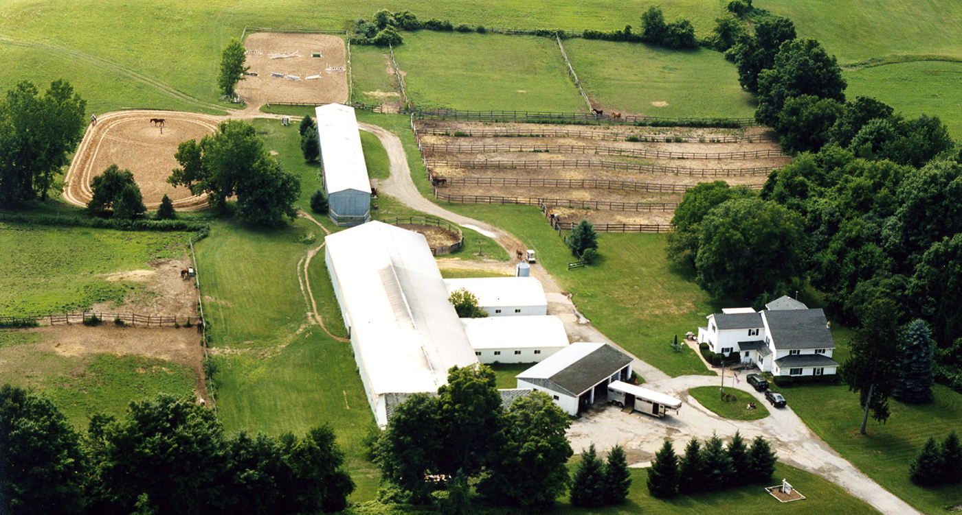
PROOF OF BENEFICIAL USE
When Can I Submit Proof?
Anytime the project is complete!
  No penalty for submitting proof early
  Do not have to wait for proof due date
Notes:
Forms for preparing proof of beneficial use are available by visit to division offices, by mail, or on the division website.
Proof must be prepared by a professional engineer or land surveyor, who is licensed in Utah and is responsible for accuracy in depicting the completed project and use of water.
The proof form is field examined and reviewed by regional office personnel.
If significant corrections are needed, the proof is returned to the engineer or surveyor for amendment. If the constructed project is considerably different than as proposed under the application, a change application may be required to describe the differences and to advertise them to the public. (See application process described above.)
If the proof is acceptable, a draft certificate of beneficial use is prepared. The regional office staff transfer it to the Applications/Records section.
If the proof is not acceptable due to errors, lack of data or signatures, or lack of physical evidence to support the written information, it is rejected, and the application is lapsed by order of the State Engineer. This action is subject to reconsideration and appeal as described above.
If the proof document was inappropriately submitted, the applicant could potentially file a late extension request to ask for more time to address further development of the project or legal issues. This could result in reduction of the priority of the application.
If the proposed project under the application has been completed as desired by the applicant (and as limited by the application itself), the applicant of record can file evidence of this development through proof of beneficial use forms. These forms are available by visit to division offices, by mail, or on the division website. Only the applicant of record can file proof. If title has changed since the initiation of the application process, ownership documentation must be accomplished through filing of a report of conveyance to update the public record.
Proof must be prepared by a professional engineer or land surveyor, who is licensed in Utah and is accountable for accuracy in depicting the completed project and use of water.
After submission, the proof form is field examined and reviewed by regional office personnel.
If significant corrections are needed, the proof is returned to the engineer or surveyor for amendment. If the constructed project is considerably different than as proposed under the application, a change application may be required to describe the differences and to advertise them to the public. For example, sometimes the drilled well is a considerable distance away from the location proposed in the application. Sometimes all of the proposed uses have not been developed, and the remaining uses have been enlarged over the original filing in order to utilize all of the water. The amending change application must be processed in the same manner as any other application. However, if approved, it does not carry a proof-due date inasmuch as the proof documents have already been submitted.
When and if the proof is acceptable, a draft certificate of beneficial use is prepared by regional office staff for review by the Applications/Records section.
If the proof is not acceptable due to errors, lack of data or appropriate signatures, or lack of physical evidence to support the written information, it is rejected by order of the State Engineer, and the application is lapsed. No further diversion and use of water are authorized under the application and they must cease until appropriate water rights are obtained. This action is subject to reconsideration and appeal as described above.
If the proof document was inappropriately submitted, the applicant could potentially file a late extension request to ask for more time to address further development of the project or legal issues. This could result in reduction of the priority of the application.

Slide 5
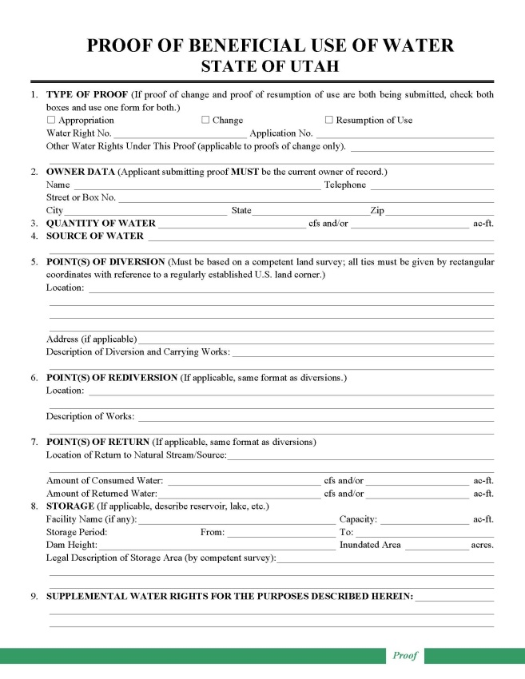
PROOF OF BENEFICIAL USE
Submitted on applications to Appropriate, Change, or Exchange Water
Professional preparation
  Survey/map POD/POU
  Obtain Measurement
  Credibility
Reviewed for completeness
Notes:
Forms for preparing proof of beneficial use are available by visit to division offices, by mail, or on the division website.
Proof must be prepared by a professional engineer or land surveyor, who is licensed in Utah and is responsible for accuracy in depicting the completed project and use of water.
The proof form is field examined and reviewed by regional office personnel.
If significant corrections are needed, the proof is returned to the engineer or surveyor for amendment. If the constructed project is considerably different than as proposed under the application, a change application may be required to describe the differences and to advertise them to the public. (See application process described above.)
If the proof is acceptable, a draft certificate of beneficial use is prepared. The regional office staff transfer it to the Applications/Records section.
If the proof is not acceptable due to errors, lack of data or signatures, or lack of physical evidence to support the written information, it is rejected, and the application is lapsed by order of the State Engineer. This action is subject to reconsideration and appeal as described above.
If the proof document was inappropriately submitted, the applicant could potentially file a late extension request to ask for more time to address further development of the project or legal issues. This could result in reduction of the priority of the application.
If the proposed project under the application has been completed as desired by the applicant (and as limited by the application itself), the applicant of record can file evidence of this development through proof of beneficial use forms. These forms are available by visit to division offices, by mail, or on the division website. Only the applicant of record can file proof. If title has changed since the initiation of the application process, ownership documentation must be accomplished through filing of a report of conveyance to update the public record.
Proof must be prepared by a professional engineer or land surveyor, who is licensed in Utah and is accountable for accuracy in depicting the completed project and use of water.
After submission, the proof form is field examined and reviewed by regional office personnel.
If significant corrections are needed, the proof is returned to the engineer or surveyor for amendment. If the constructed project is considerably different than as proposed under the application, a change application may be required to describe the differences and to advertise them to the public. For example, sometimes the drilled well is a considerable distance away from the location proposed in the application. Sometimes all of the proposed uses have not been developed, and the remaining uses have been enlarged over the original filing in order to utilize all of the water. The amending change application must be processed in the same manner as any other application. However, if approved, it does not carry a proof-due date inasmuch as the proof documents have already been submitted.
When and if the proof is acceptable, a draft certificate of beneficial use is prepared by regional office staff for review by the Applications/Records section.
If the proof is not acceptable due to errors, lack of data or appropriate signatures, or lack of physical evidence to support the written information, it is rejected by order of the State Engineer, and the application is lapsed. No further diversion and use of water are authorized under the application and they must cease until appropriate water rights are obtained. This action is subject to reconsideration and appeal as described above.
If the proof document was inappropriately submitted, the applicant could potentially file a late extension request to ask for more time to address further development of the project or legal issues. This could result in reduction of the priority of the application.

Slide 6
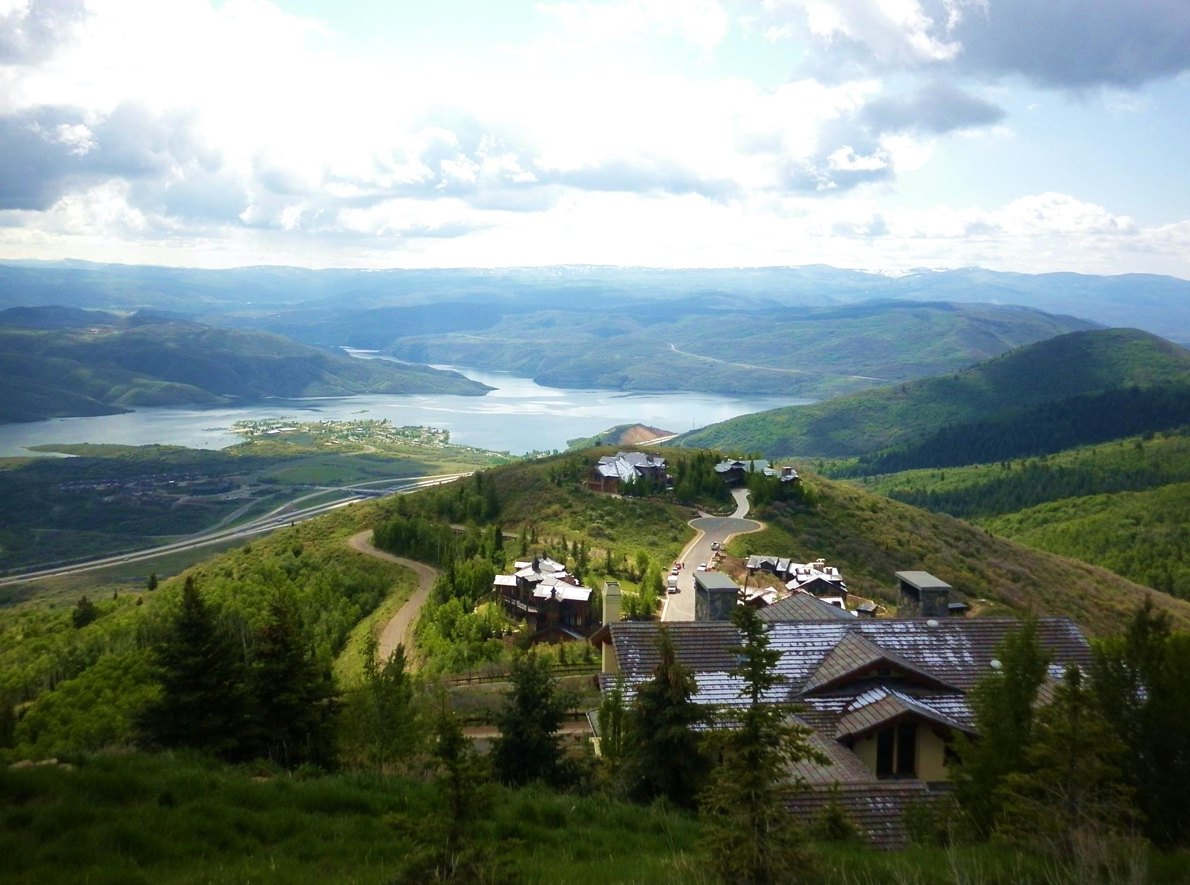
Affidavit of Beneficial Use
Perfecting small domestic water rights

Slide 7

Affidavit of Beneficial Use
(PROOF AFFIDAVIT)
Small domestic uses
  1 house,
  0.25 acres irrigation or less
  10 livestock or less
Use the online affidavit tool to help streamline the process.
Certificate of Occupancy (Can accept tax notice).
Affidavit of Beneficial Use of Water Form
Plat Map (requirement waived if you use the affidavit tool).
Map of Beneficial Use

Slide 8
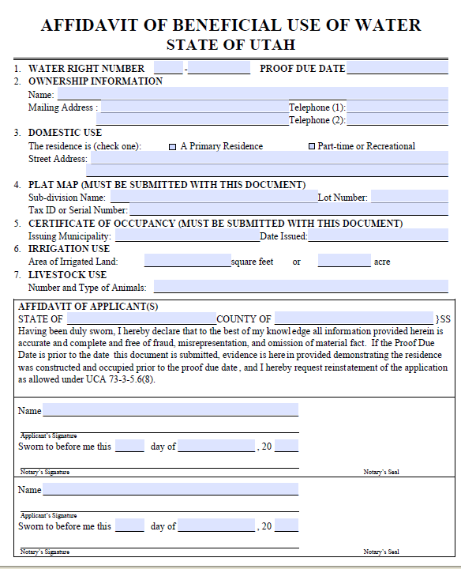
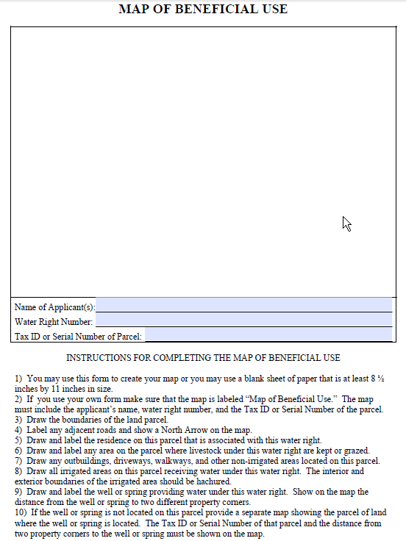
PROOF AFFIDAVIT FORM

Slide 9
PROOF AFFIDAVT
Map of Beneficial Use Example
If using the blank form, you will need to provide a map showing:
  Boundaries of the land parcel
  House Location
  Areas where irrigation is occurring
  Livestock watering troughs and grazing areas
  Outbuildings, walkways, driveways, non-irrigated areas
  Well location with distance from two property corners
  North arrow and legend

Slide 10
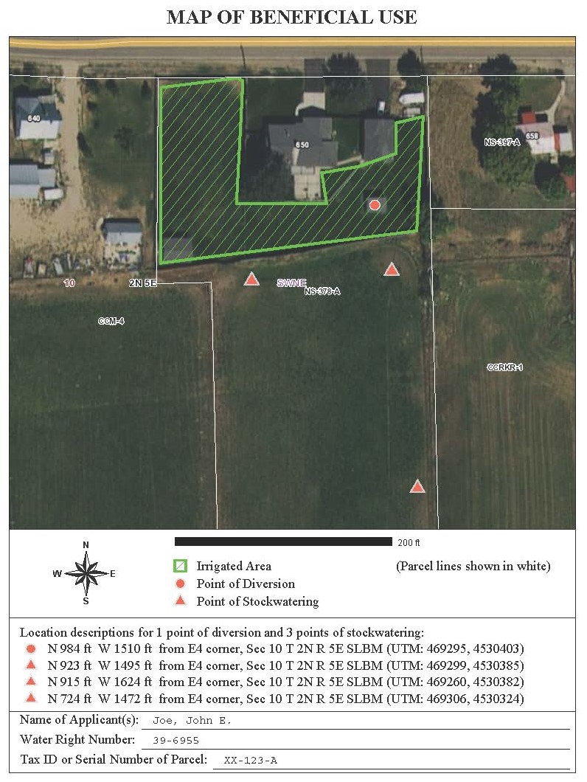
PROOF AFFIDAVT
Map of Beneficial Use Example
If using the Affidavit Wizard:
Program will walk you through the map making process
Will generate a proof affidavit map from your inputs
Easy for staff to review with current aerial photography

Slide 11
PROOF
Frequently Asked Questions
What happens to my proof?
  Acceptable proof gets a “Certificate of Beneficial Use”
  If unacceptable you will be contacted for clarification
Do I have to fill out an Affidavit myself?
  You can hire a proof professional (surveyor, engineer or consultant) to help you file the Affidavit
What if I can’t get a Certificate of Occupancy?
  Tax Records showing a residence is being taxed or a letter from municipality are acceptable
Who needs to sign the Affidavit?
  All owners listed on the Water Right in the DWRi database
  If based on shares of stock in an irrigation company, the irrigation company also needs to sign the proof
What do I need to do after receiving my Certificate?
  Continue use as authorized
  Amendments by change application

Slide 12

Updating ownership
Water Right Title

Slide 13

How Water Right Conveyance Works
Water Rights transfer by deed in substantially the same manner as real estate.
Appurtenant water rights transfer silently with land.
  Unless specifically reserved from transfer in land deeds!
Deed conveying water right must be recorded:
  In county where water is used (place of use)
  County where water is diverted (if the two are different)

Slide 14
Water Right Record Keeping
Records maintained by County Recorder
  Deeds (conveyance of water right)
  Certificate of Beneficial Use (if recorded)
  Index of water deeds
  Assignments (Transfer unapproved/unperfected WR)
Records maintained by the State Engineer
  Water Right Applications
  Certificate of Beneficial Use
  Use Records
  Owner of record
  Other water rights related documents

Slide 15
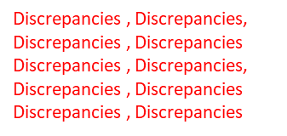
Water Right Record Keeping
Records maintained by County Recorder
  Deeds (conveyance of water right)
  Certificate of Beneficial Use (if recorded)
  Index of water deeds
  Assignments (Transfer unapproved/unperfected WR)
Records maintained by the State Engineer
  Water Right Applications
  Certificate of Beneficial Use
  Use Records
  Owner of record
  Other water rights related documents
Discrepancies , Discrepancies, Discrepancies , Discrepancies Discrepancies , Discrepancies, Discrepancies , Discrepancies Discrepancies , Discrepancies

Slide 16
Updating Ownership with the Division of Water Rights
Who Can Update?
How are the Records Updated?
  Owner if all submitted deeds convey by water right number
  Attorney
  Professional engineer
  Title insurance producer
  Professional land surveyor
  Report of Conveyance (ROC)
    One ROC for each water right to be updated
    ROC chain of ownership begins with the owner on the Division’s records
    Shows the Division who the current owner is

Slide 17
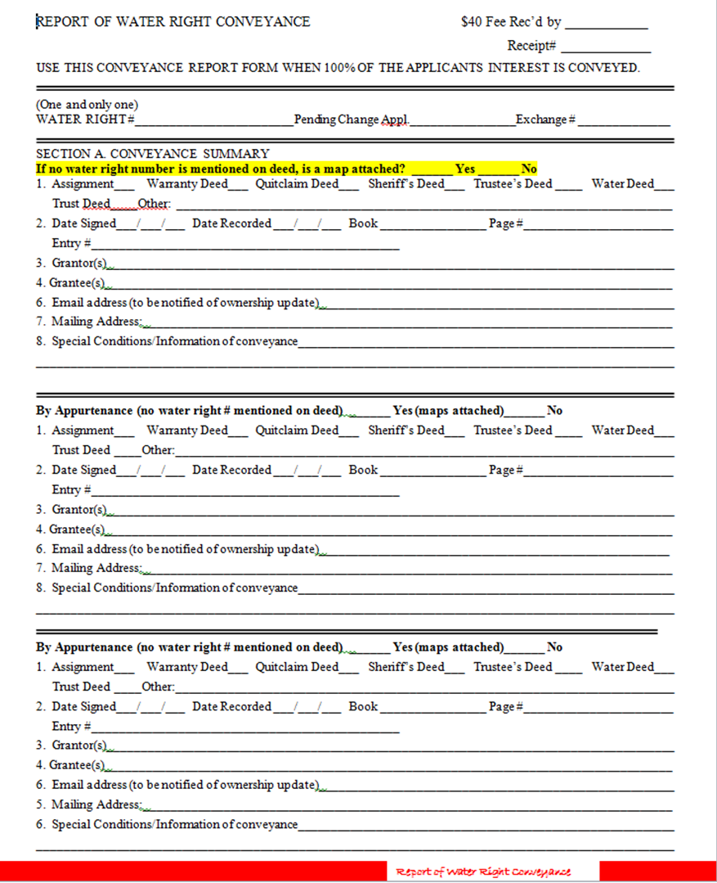

Slide 18
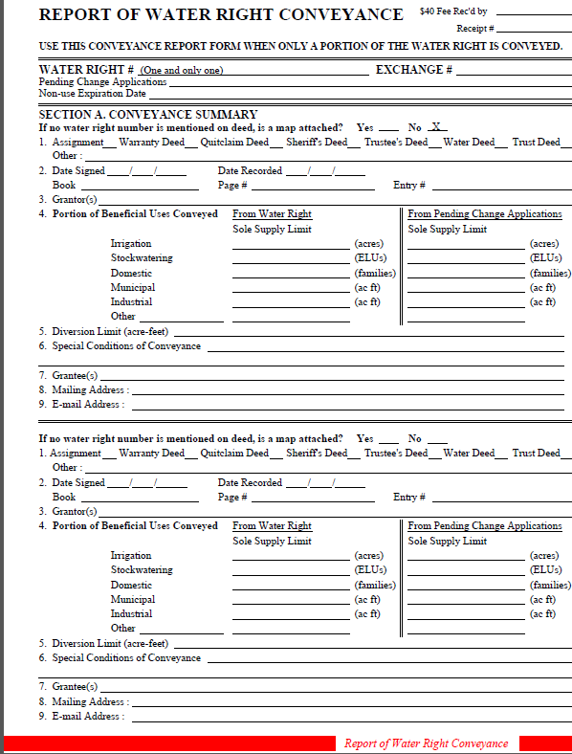
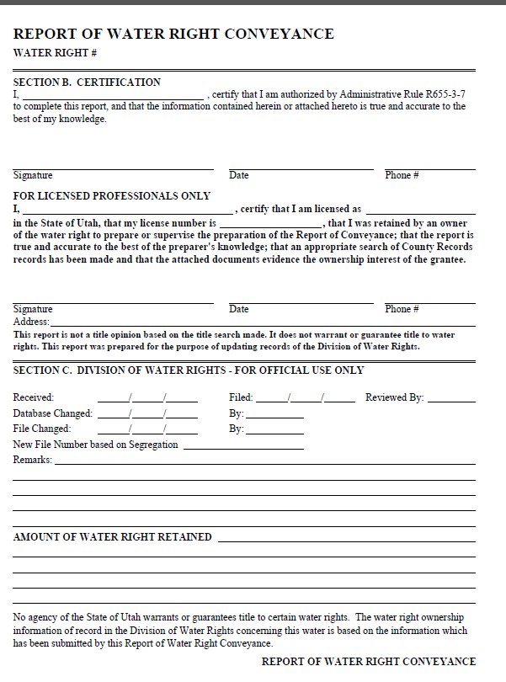

Slide 19
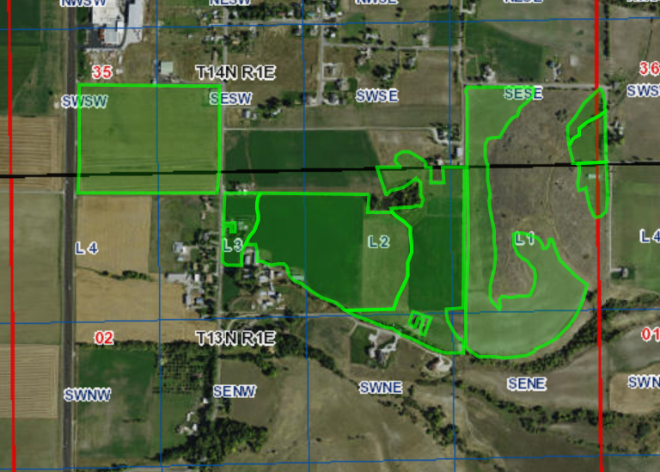

Section 35, T14N, R1E and Section 2, T13N, R1E
Section Corner
Water Right #
Parcel 1
28.1 acres
North Arrow
Scale
SE
Corner
Parcel 2
63.3 acres
Parcel
Acreage
Legends
WR# 25-6734
N
Parcels 1 (28.1 acres) & 2 (63.3 acres) (Deed # 7240)
POU for water right # 25-6734
*Map MUST clearly show property described in deed

Slide 20
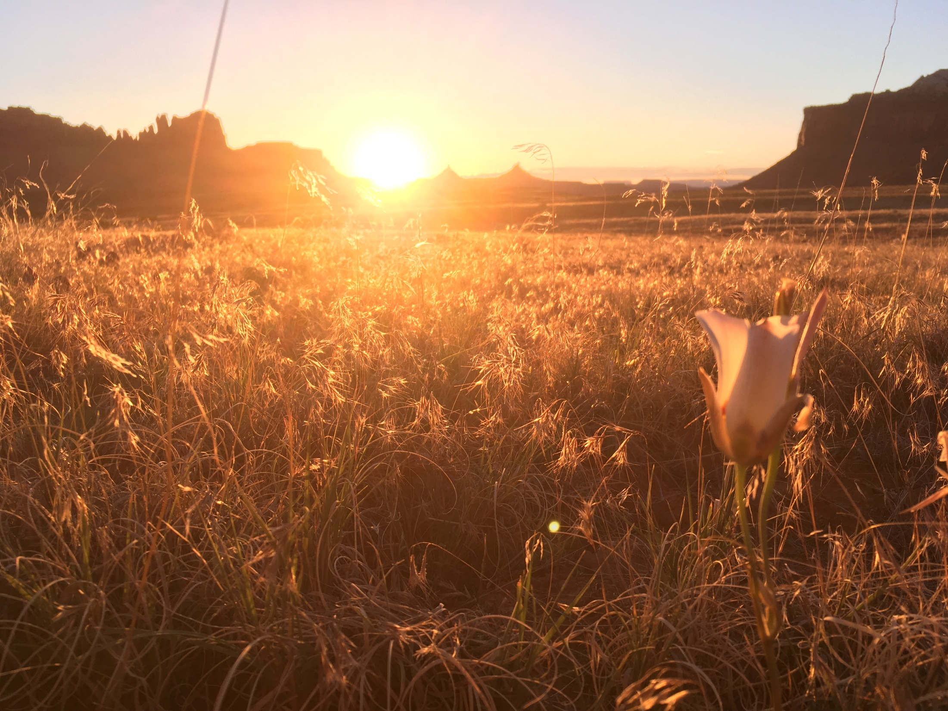
Land and water deed
Addendums

Slide 21
Addendums
Utah Code Ann. §73-3-8
(ii) The state engineer shall consider a water rights addendum that is recorded and forwarded to the state engineer by a county recorder, in accordance with Section 57-3-109, as a submitted report of water right conveyance under Subsection (3).
Creates dialogue about what water rights are conveyed
County recorder submits to SE
Attachment to deed
All grantors/grantees sign
Win-win situation
The grantee must keep current mailing address with DWRi

Slide 22
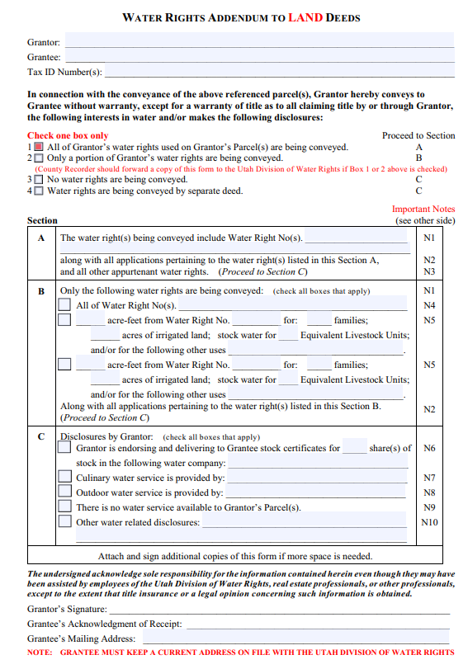
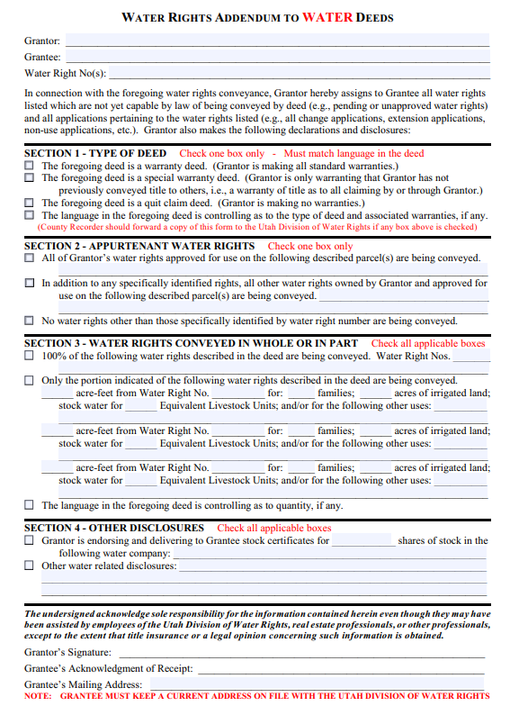

Slide 23

Title Takeaways
Report of Conveyance (ROC)
  Report of Conveyance normally requires professional (Attorney, Engineer, Surveyor, or Title Insurance Agent)
  Transfers by appurtenance require a map
  Simple transfers can be completed by the owner (deeds list WR number)
  Competing ROCs are a title controversy
    State Engineer does not resolve
  Conduct proper “due diligence” research into any water right before purchasing it.
The mere purchase of a water right does not guarantee: (1) that the water right is in good standing with the Utah Division
of Water Rights; (2) that the owner has clear title to the water right: (3) that the Division will recognize the ownership change;
or (4) that the Division will approve any proposed changes or extensions regarding the water right. You are encouraged to
conduct proper “due diligence” research into any water right before purchasing it.

Slide 24
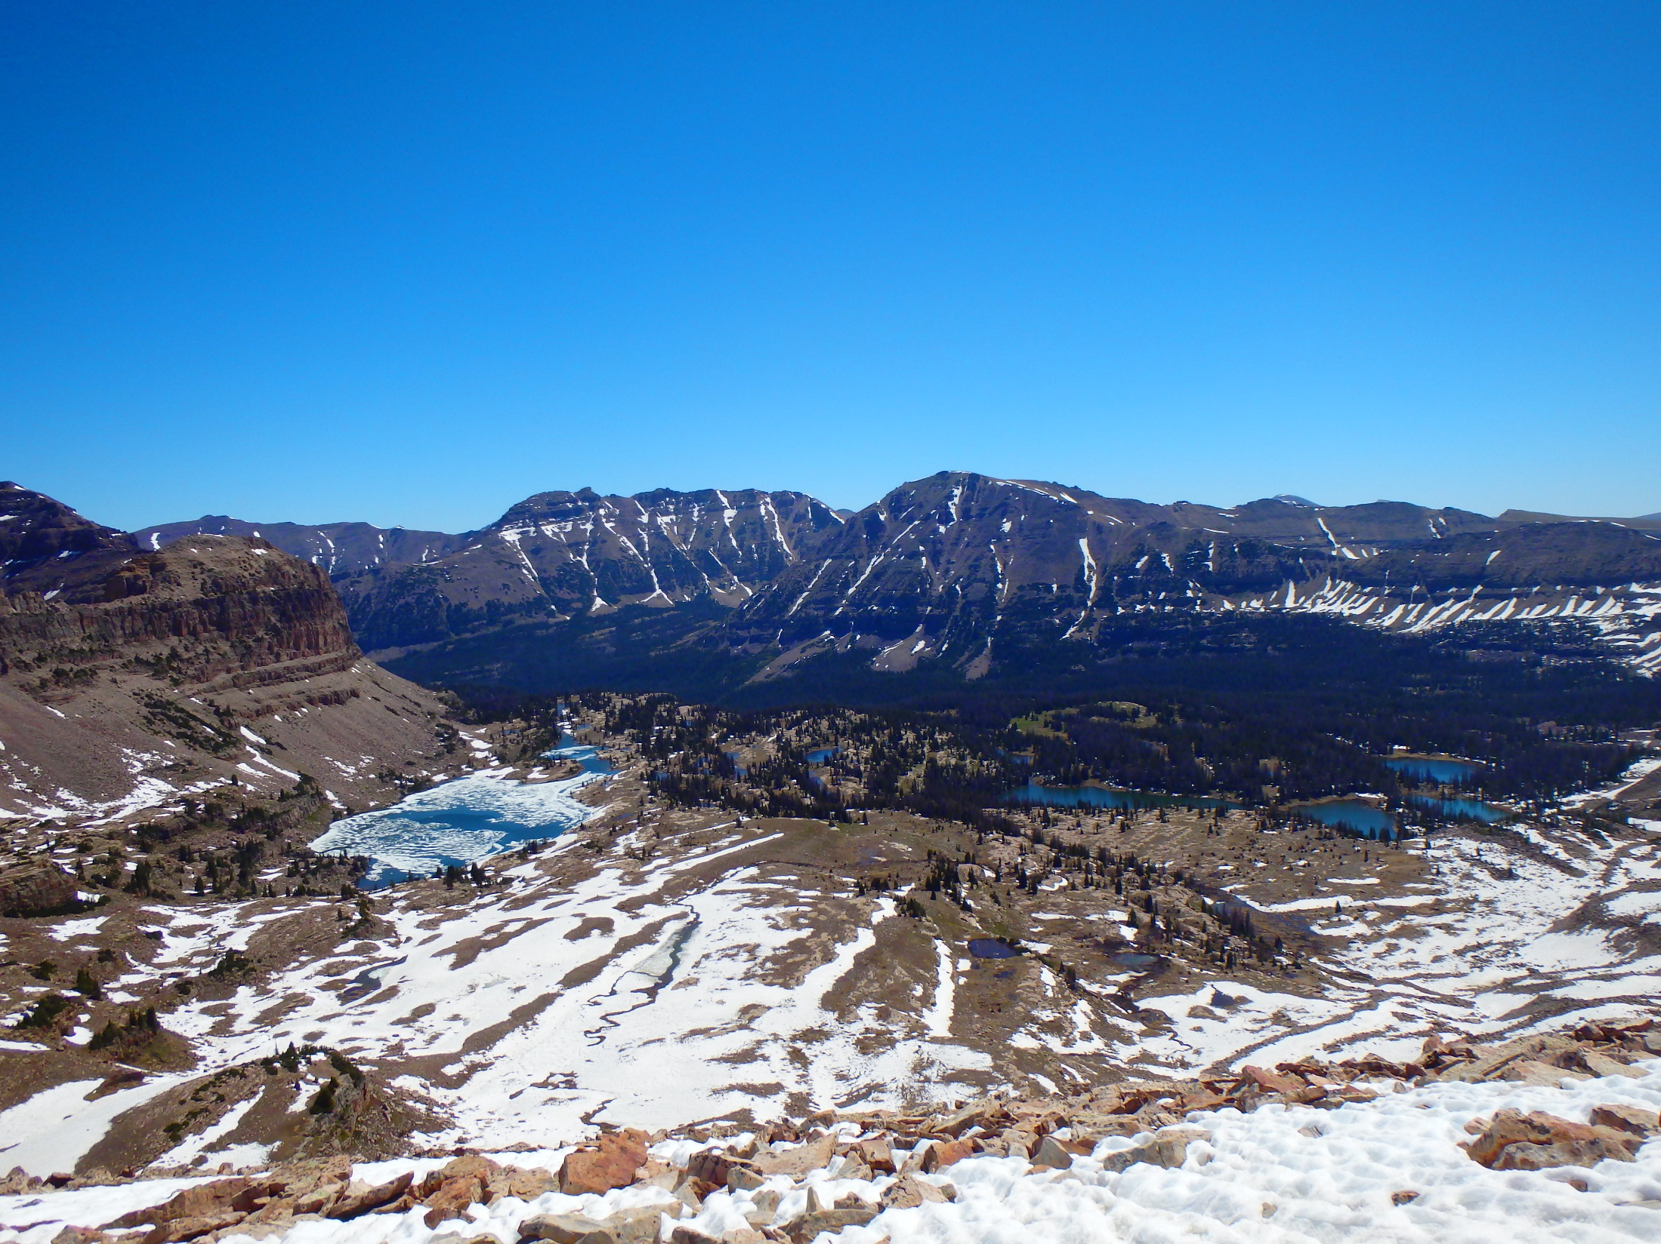
Questions?
NO? Great!
Please keep ownership and contact information updated with DWRi

